Slide 1


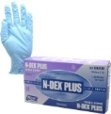
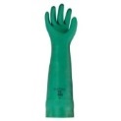
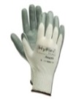
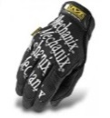





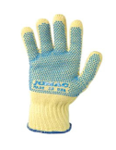
Glove Matrix**
 | CHEMICAL RESISTANT And CATERING | CHEMICAL RESISTANT | LIGHT DUTY | MEDIUM DUTY | IMPACT RESISTANT HEAVY DUTY | ABRASION RESISTANT MEDIUM DUTY | HEAT RESISTANT | ELECTRICAL | THEMALLY INSULATED | CUT RESISTANT BUTCHER GLOVE | CUT RESISTANT KEVLAR
Application
Delicate and Precise | x | x | x
Light Handling | x | x | x | x
Medium Handling |  |  |  | x | x | x
Catering work/Food handling | x
Rigging |  |  |  | x | x | x
Heavy Handling |  |  |  |  | x
Working With Power Tools |  |  |  | x | x | x
Pipe and Flange Working |  |  |  |  | x
General Construction |  |  |  | x | x | x
Risk of Cut or Slice to Hand |  |  |  |  |  |  |  |  |  | x | x
Packing | x |  | x | x
Plant Maintenance |  |  |  | x | x | x
Chemicals and Hazardous Substances | x | x
Improved Grip in Wet Oily Conditions |  |  | x |  | x
Electrical Work/Glanding |  |  |  |  |  |  |  | x
Cold Conditions |  |  |  |  |  |  |  |  | x
Welding/Hotwork |  |  |  |  |  |  | x
**Shell is not promoting a particular brand or manufacturer of gloves, we are promoting the proper type of glove for the identified task.

