Slide 1
Americas - Air Transport Update
Safe Transport of Personal Electronic Devices (PEDs)
Effective October 1, 2025

Slide 2
Bottom Line Up Front (BLUF)
Objectives
To inform all passengers being transported on a Shell-contracted helicopter in the Americas on upcoming changes to IOGP aviation industry requirements that are being implemented to mitigate lithium battery fire/thermal runaway hazards when transporting personal electronic devices (PEDs) via air.
Key Messages
Lithium battery fires/thermal runaway hazards are directly associated with PEDs
  Numerous lithium battery fire/thermal runaway incidents have occurred across the aviation industry over the last several years.
  Effective 1 October 2025, E-cigarettes, vapes, and power banks will not be permitted on offshore flights.
  Mobile phones, earbuds, fitness trackers, and smart watches shall be switched OFF (if possible) and transported on the passenger.
  Laptops and tablets shall be switched OFF and transported in a protective case/packaging in the aircraft baggage compartment.

Slide 3
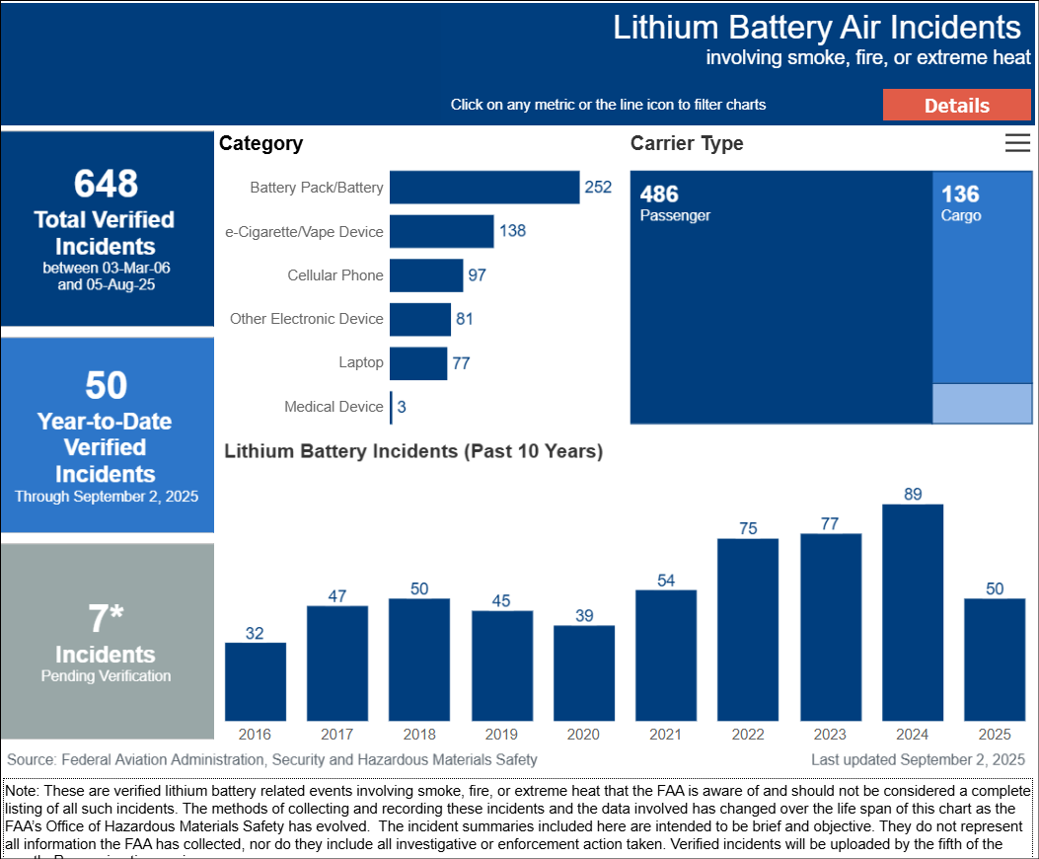
Personal Electronic Devices - Lithium Battery Incidents (Data Provided by the FAA)
Links:
Lithium Battery Incidents | FAA Info
Lithium Batteries: What’s the risk?
Video sample 1
Video sample 2

Slide 4
Hazard - Personal Electronic Devices - Battery Fires / Thermal Runaway
Lithium battery fires/ thermal runaway while onboard an aircraft has been identified by the FAA and IOGP members as a most likely credible scenario.
Numerous lithium battery fire/thermal runaway incidents have occurred across the aviation industry
Effective 1 October 2025, E-cigarettes, vapes, and power banks will not be permitted on offshore flights.
Large personal electronic devices (PEDs), such as laptops, iPads, and tablets are powered by lithium batteries that can catch fire in the baggage compartment of the aircraft, forcing an aircraft ditching scenario.
  Laptops and tablets shall be completely switched OFF to avoid the battery overheating or catching fire while stored in the back of the aircraft (inaccessible).
    Designated facility personnel (onshore/offshore) shall verify that PEDs are completely powered OFF prior to flight.
    Post-flight audits will continue to identify trends of non-compliance. Laptops and tablets have been found not switched OFF.
  Laptops and tablets shall be transported in a protective case or packaging. Devices with physical damage shall not be transported because a damaged battery is more likely to catch fire.
    Passengers shall pack their laptop computers, cameras, and/or large electronic devices in impact resistant cases designed for air transport or suitably protected in other type baggage to prevent damage. Placing “Fragile” or other such tags on baggage is the passenger’s responsibility.
    Mobile phones, earbuds, fitness trackers, and smart watches shall be switched OFF (if possible) and carried in a protective case on the passenger. Smart watches may be worn on the passengers (no protective case needed if worn).
      The safety poster provided on the next slide should be posted in offshore passenger safety briefing rooms.

Slide 5
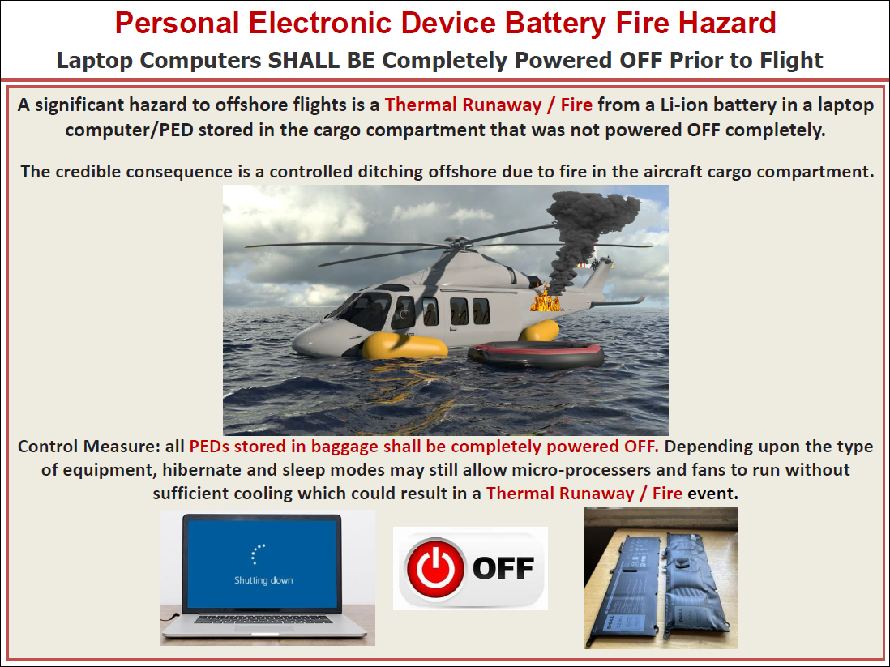

Slide 6
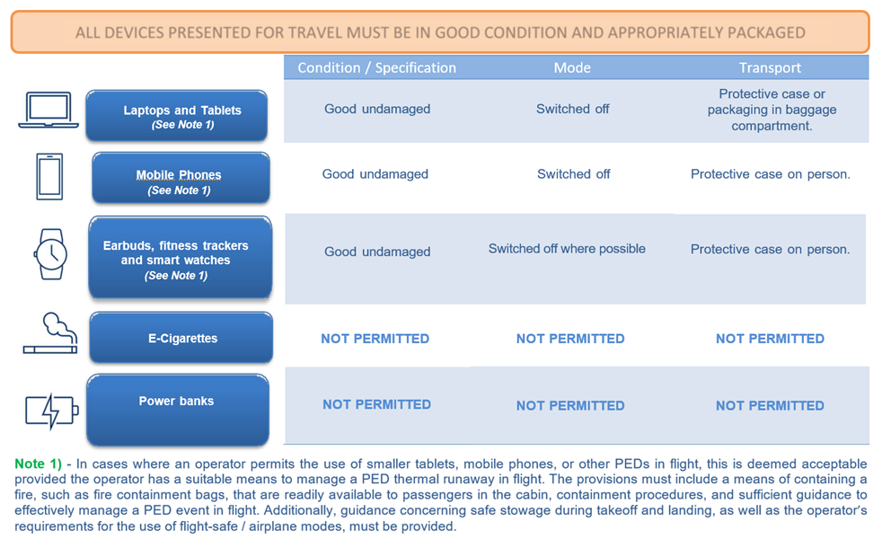
E-Cigarettes / Vapes / Power Banks
Recent IOGP 690 changes require that e-cigarettes, vapes, and power banks be prohibited on all offshore flights.
Many disposable vapes and e-cigarettes use cheap lithium batteries. These batteries may lack proper safety features, like thermal cut offs, making them more prone to overheating and catching fire.
The FAA states that e-cigarettes were the leading cause of lithium battery incidents.
What is a “power bank”? a portable device that consists of a battery, input and output ports, and a control circuit that regulates the flow of electricity. It serves as an external battery for cell phones, tablets, etc., which can power a personal electronic device (PED).

Slide 7
E-Cigarettes / Vapes / Power Banks (continued)
Appropriately packaged refers to transporting PEDs in protective cases or other packaging to prevent physical damage. The goal is to minimize the chance of impacts, punctures, or defects that could compromise the integrity of the device's battery and/or circuitry. Given the variety of PEDs, specific packaging types are impossible to specify. Instead, the focus is on ensuring the packaging provides adequate protection against common hazards during transportation. This typically means using commercially available cases designed specifically for the device. Devices should not be carried unprotected.
Switched OFF where specified, means that the device is powered off and not able to run background processes or allow receiving and transmitting functions such as “find my device” or dwell in a sleep or hibernate mode.

Slide 9
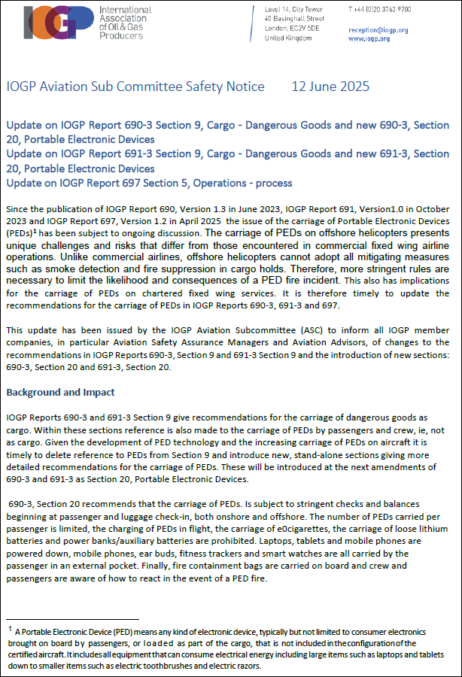
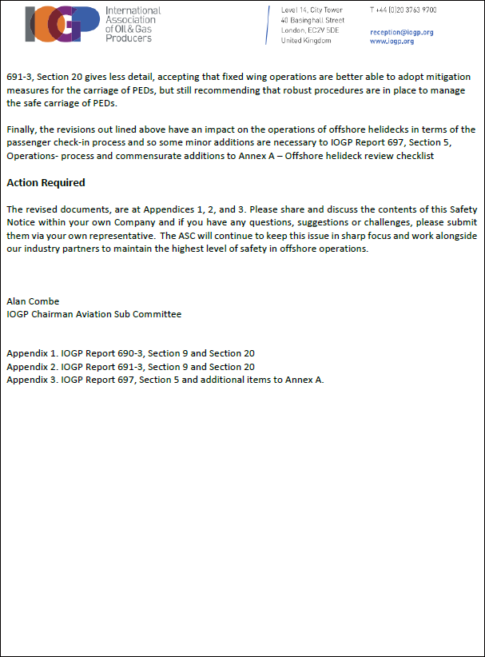

Slide 10
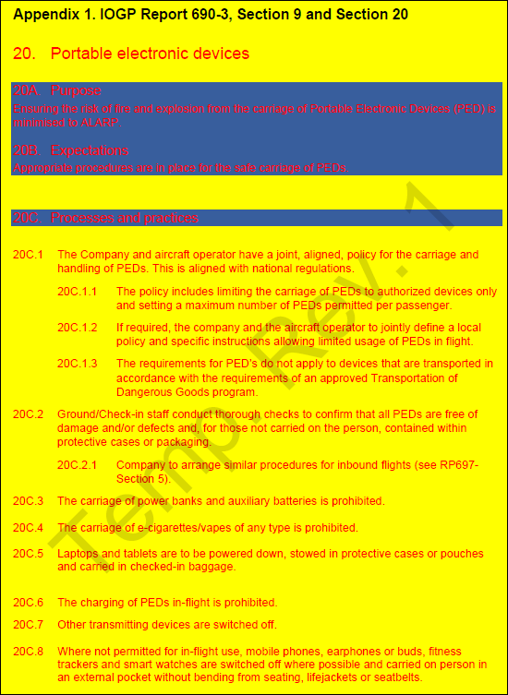
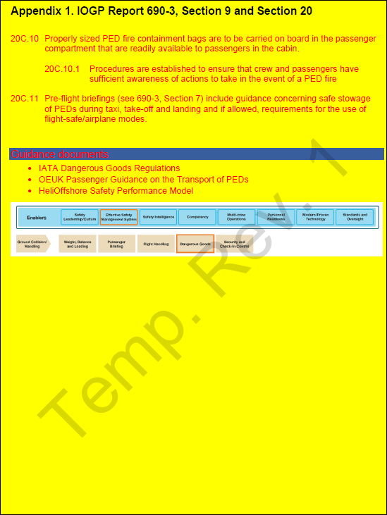
IOGP 690

